Slide 1

MOVIE RECOMMENDER SYSTEMS
Vijit Singh
Kanav Bansal
Mentors
Team Members​
Koukuntla Komal Reddy​
Chalumuri Harshitha​
Chintada Jagan Mohan Rao
Koppaka Yeswanth ​
Kalapala Venkata Surya Teja​
Asif Ahmad Najar​

Slide 2
Agenda
Problem Statement
Dataset Analysis
Models (Code Implementation)
Interpretation of Results (Evaluation Metrics)
Problems faced and Improvements
Future scope
References
Timeline

Slide 3

Problem Statement
Build a Recommender System that recommends movies based on “ Cast, Genre, Reviews, TMDB/IMDB ratings”
Why?
Recommendation systems can be an effective way to expose users to content they may not have otherwise found, which in turn can forward larger business goals like increasing sales, advertising revenues, or user engagement. The challenge lies in building a system that will actually have a business impact
Expectations?
Recommendation systems should also be agile. That is, adaptable and able to evolve as users do

Slide 4

DataSet Analysis
Datacleaning, Datapreprocessing, Exploratory Data Analysis

Slide 5
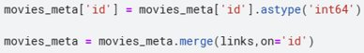
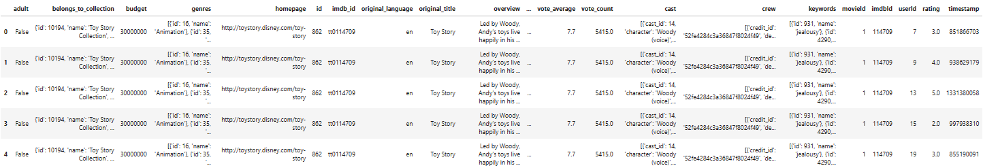
Step –1
Merging all the data sets

Slide 6
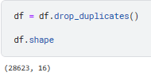
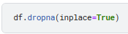
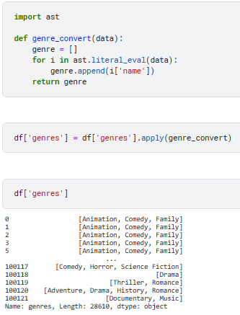
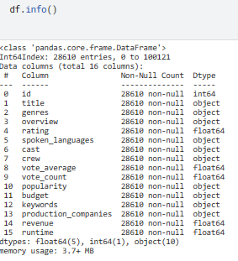
Step -2
Dropping unnecessary columns, removing duplicates and null values
This conversion is also done for crew,cast,production_companies, keywords,spoken_languages too

Slide 7
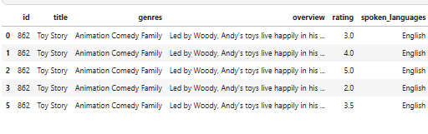
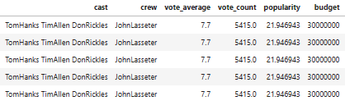
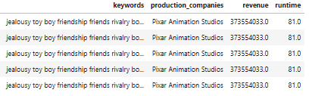
Step -3
Final Dataset

Slide 8
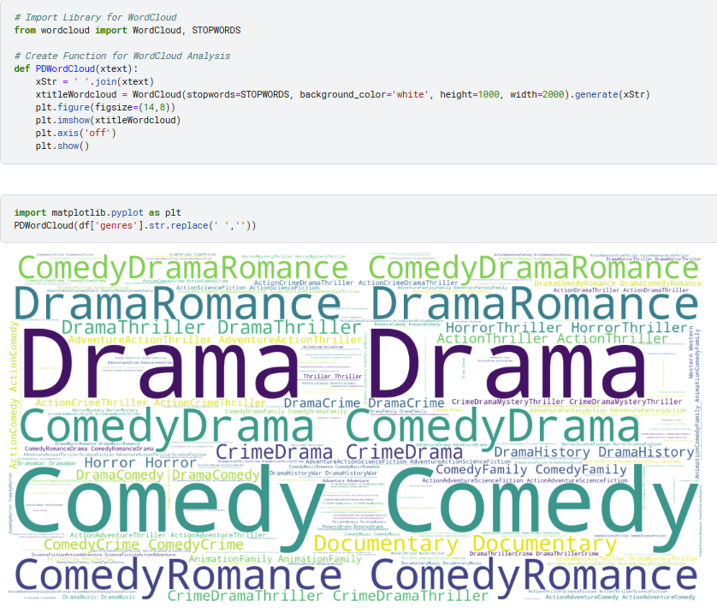
Step -4
Exploratory
Data
Analysis

Slide 9
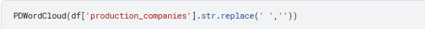
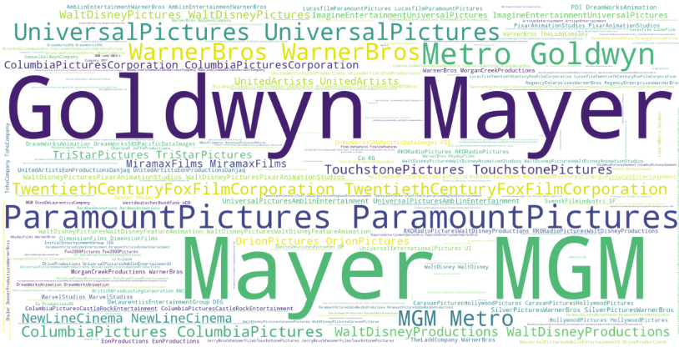

Slide 10
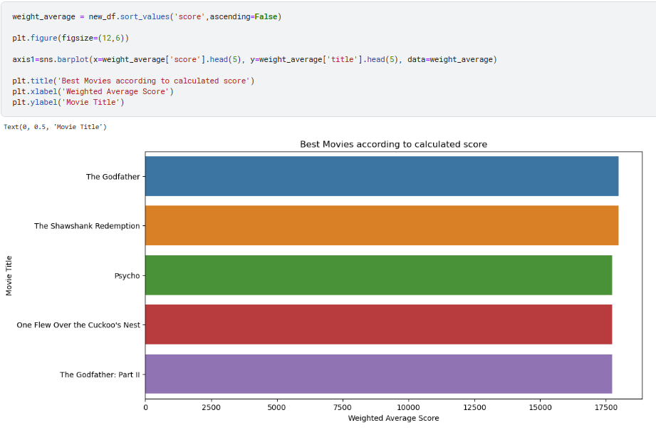
Univariate analysis

Slide 11
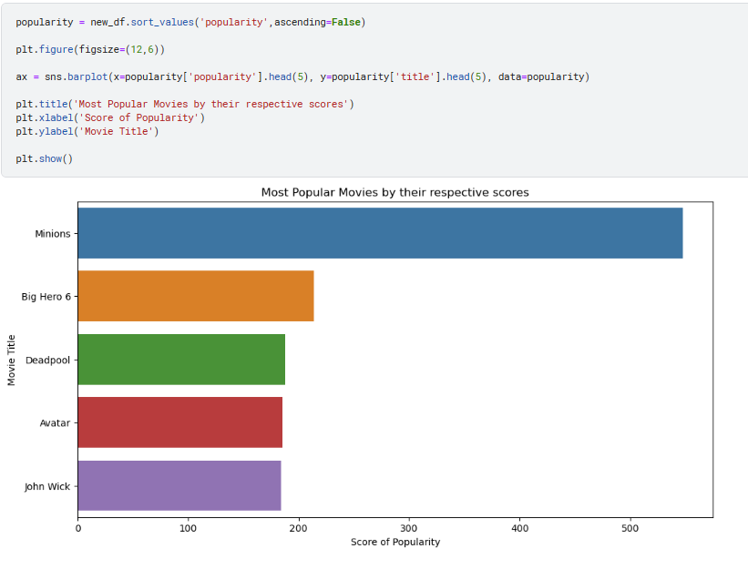
Univariate analysis

Slide 12
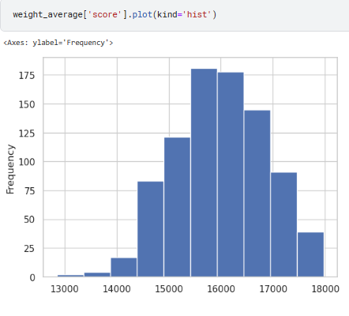
Univariate analysis
Calculation of score is explained in the next coming slides
Here we can see almost normal distribution of scores across the data set

Slide 13
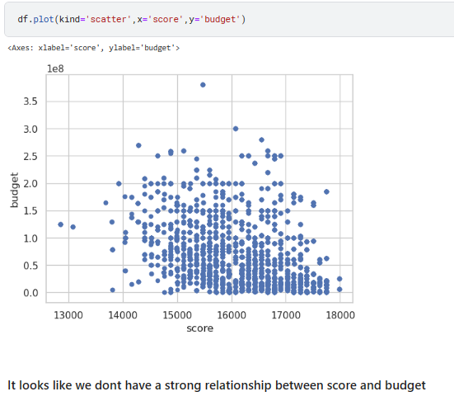
Bivariate analysis

Slide 14
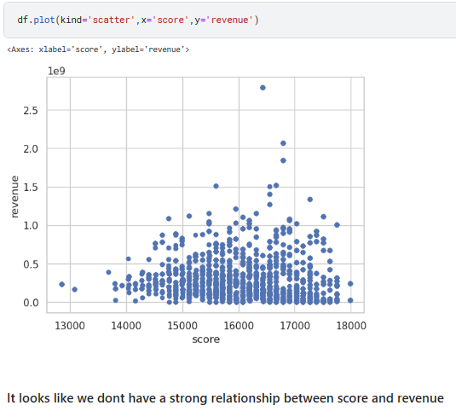
Bivariate analysis

Slide 15
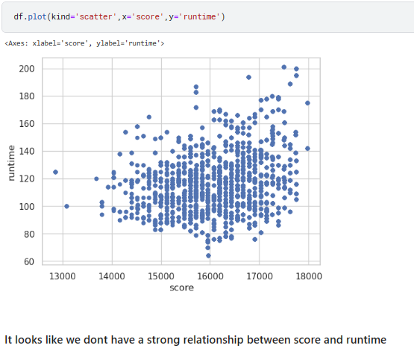
Bivariate analysis

Slide 16
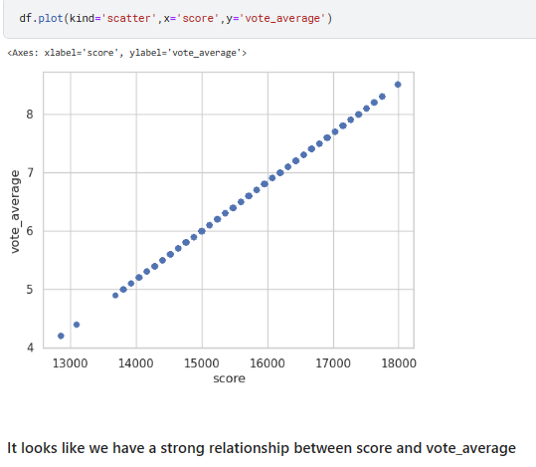
Bivariate analysis

Slide 17
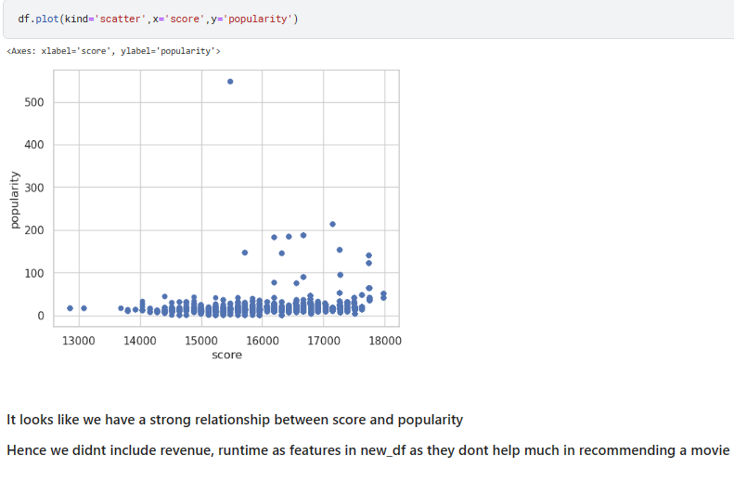
Bivariate analysis

Slide 18

Models
Code Implementation

Slide 19
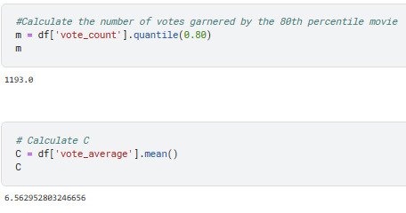
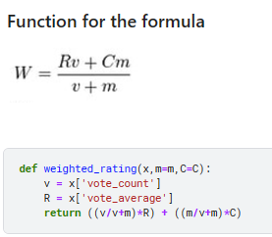
Popularity Based Recommendation

Slide 20
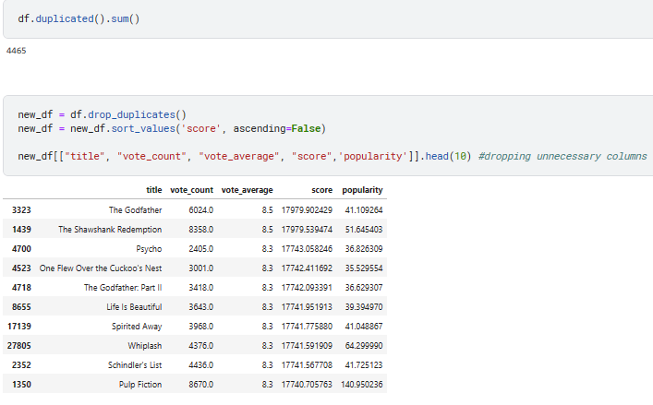
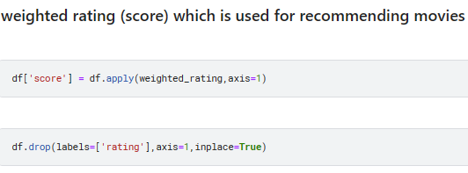

Slide 21
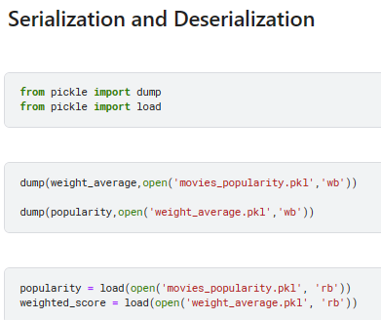

Slide 22
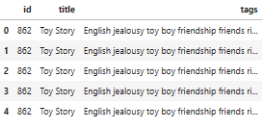
Content Based Recommendation

Slide 23
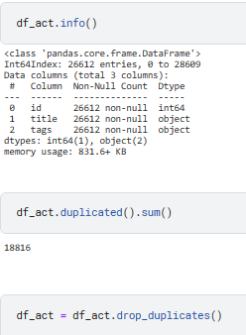
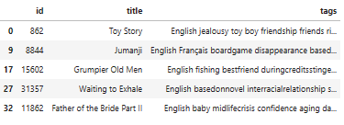
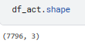

Slide 24
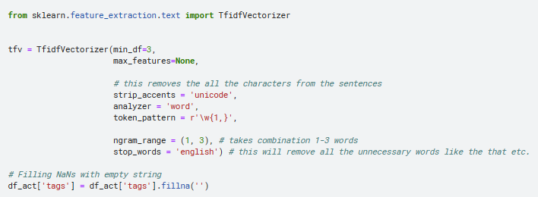
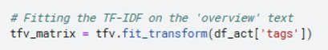
TF-IDF stands for Term Frequency Inverse Document Frequency of records. It can be defined as the calculation of how relevant a word in a series or corpus is to a text. The meaning increases proportionally to the number of times in the text a word appears but is compensated by the word frequency in the corpus (data-set).
Term frequency = count of term in document / number of words in document
Document frequency = occurrence of term in documents
Inverse document frequency = log(Number of documents/ Document frequency)
tf-idf = term frequency * Inverse document frequency

Slide 25
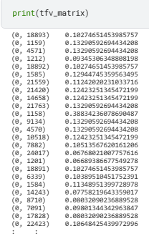
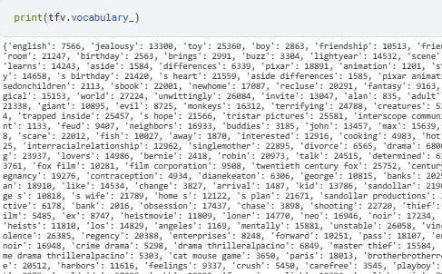
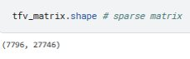
tf idf value
Word index
Word index
Document index

Slide 26
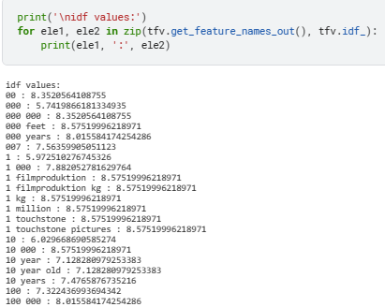
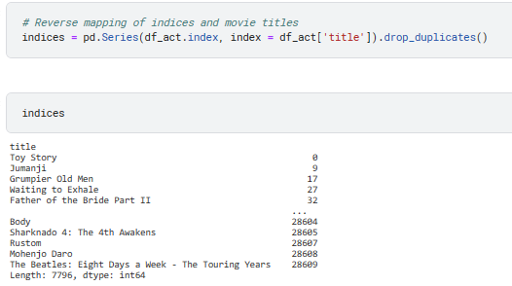
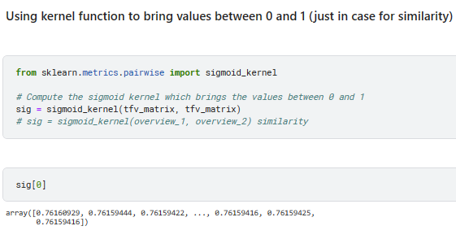

Slide 27
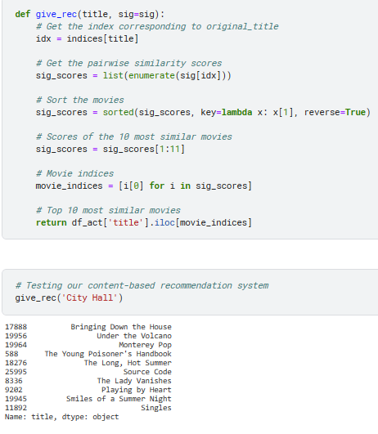

Slide 28
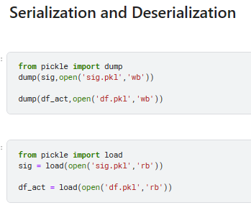

Slide 29
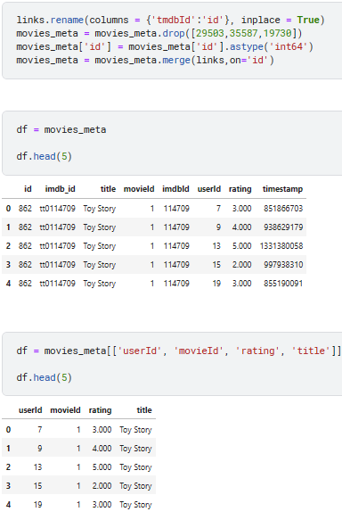
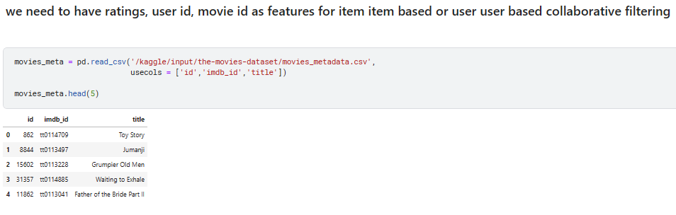
Collaborative Based Recommendation

Slide 30
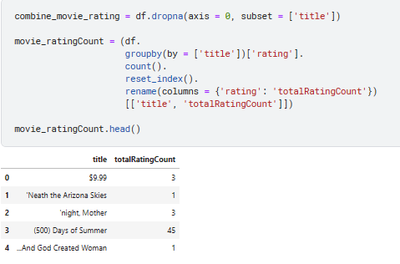
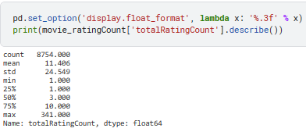
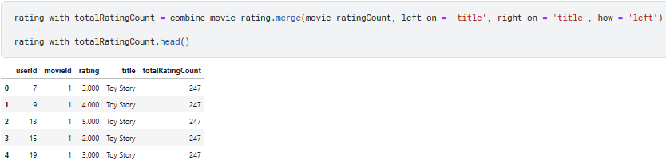

Slide 31
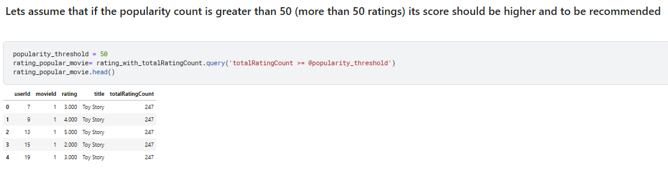
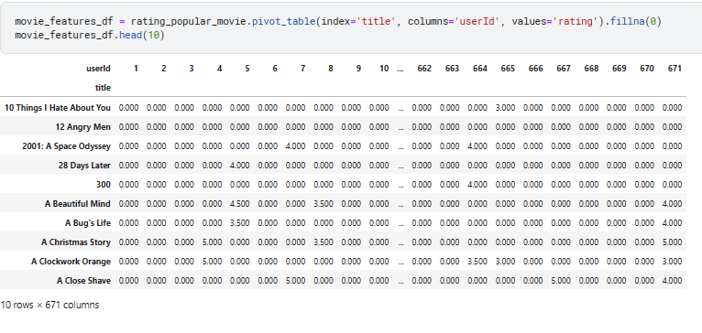

Slide 32
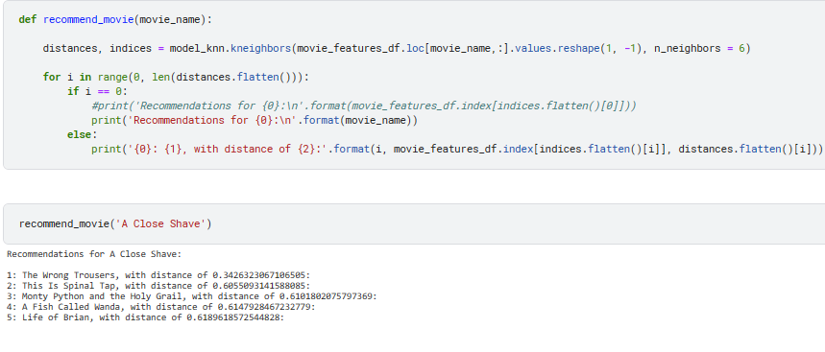
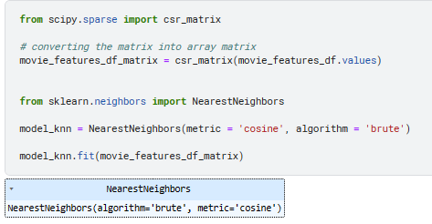
If most of the elements of the matrix have 0 value, then it is called a sparse matrix.
Representing a sparse matrix by a 2D array leads to wastage of lots of memory as zeroes in the matrix are of no use in most of the cases. So, instead of storing zeroes with non-zero elements, we only store non-zero elements. This means storing non-zero elements with triples- (Row, Column, value)

Slide 33
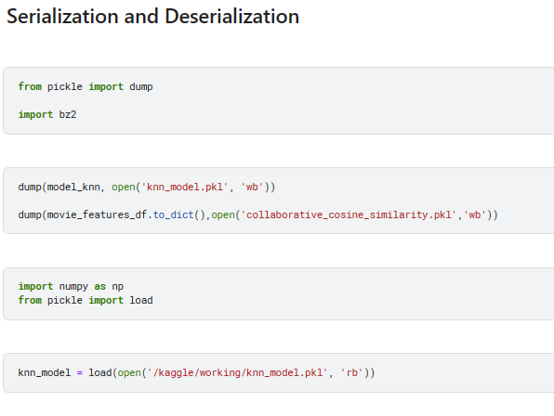

Slide 34

Evaluation metrics

Slide 35
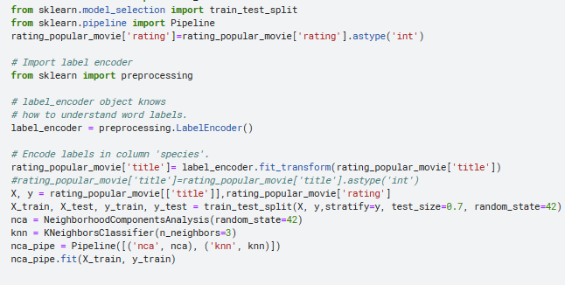

Collaborative Based
Recommendation System

Slide 36

Content Based Recommendation System

Slide 37
Problems Faced
Problems encountered and related solutions

Slide 38
In Content Based Recommendation System the movie which don’t have any related movies greater than or equal to 10 cause error(INDEX ERROR) in the app as the recommendation function defined is to filter 10 movies and sort according to scores, To avoid this we could think of variable number of movies to be filtered but this would increase model complexity and time to train , Hence on average 10 is taken for recommendation
1.

Slide 39
Accuracy Score in Collaborative Based Recommendation System is relatively low where Content Based Recommendation System outperformed with score of 97% . Insufficient data , or ineffective data cleaning may be the reasons for less score in Collaborative Based Recommendation System , adding more features and efficient preprocessing may give better result
2.

Slide 40

Future Scope

Slide 41
In the foreseeable future, our team will try to add more features , enhance the model's accuracy score by improving the data preprocessing methods and make it more interactive with less problems.

Slide 42


References

Slide 43
Similarity Based Collaborative Filtering Model for Movie Recommendation Systems | IEEE Conference Publication | IEEE Xplore
Evaluation Metrics for Recommender Systems | by Claire Longo | Towards Data Science
Enhanced Content-Based Filtering Using Diverse Collaborative Prediction for Movie Recommendation | IEEE Conference Publication | IEEE Xplore
How to Build a Movie Recommendation System | by Ramya Vidiyala | Towards Data Science

Slide 44

Timeline
25 May 2023
Data cleansing
Data preprocessing
EDA
27 May 2023
Building Model
29 May 2023
Model Serialization and Deserialization
31 May 2023
Deployment
3 June 2023
Final Report Generation

Slide 45
Summary
The project is expected to be a valuable contribution to the field of recommender systems. The system will be able to recommend movies to users based on their past ratings and preferences, which will help users to discover new movies that they are likely to enjoy. The project is also a valuable learning experience for the team members.

Slide 46

As a Team Thank You
WE
Project manager: @ Koukuntla Komal Reddy
Data scientist: @ Koppaka Yeswanth
Software engineer: @ Chalumuri Harshitha
User experience designer: @ Kalapala Venkata Surya Teja
Documentation writer:@ Asif Ahmad N
Quality assurance engineer:@ Chintada Jagan Mohan Rao

